Slide 1
Programming Using the
Message Passing Paradigm

Slide 2
MPI_Wait
MPI_Wait is a blocking call that returns only when a specified operation has been completed (e.g., the send buffer is safe to access).
MPI_Wait (request, status)
https://rookiehpc.github.io/mpi/docs/mpi_wait/index.html

Slide 3
MPI_Test
MPI_Test is the nonblocking counterpart to MPI_Wait. Instead of blocking until the specified message is complete, this function returns immediately with a flag that says whether the requested message is complete (true) or not (fals
MPI_Test (request,flag,status)
https://rookiehpc.github.io/mpi/docs/mpi_test/index.html

Slide 4
Sending and Receiving
Messages Simultaneously
To exchange messages, MPI provides the following function:
int MPI_Sendrecv(void *sendbuf, int sendcount,
MPI_Datatype senddatatype, int dest, int sendtag, void *recvbuf, int recvcount, MPI_Datatype recvdatatype, int source, int recvtag, MPI_Comm comm, MPI_Status *status)

Slide 5
Collective Communication and Computation Operations
MPI provides an extensive set of functions for performing common collective communication operations.
Each of these operations is defined over a group corresponding to the communicator.
All processors in a communicator must call these operations.

Slide 6
Collective Communication Operations
The barrier synchronization operation is performed in MPI using:
  int MPI_Barrier(MPI_Comm comm)
The one-to-all broadcast operation is:
  int MPI_Bcast(void *buf, int count, MPI_Datatype datatype, int source, MPI_Comm comm)
The all-to-one reduction operation is:
  int MPI_Reduce(void *sendbuf, void *recvbuf, int count, MPI_Datatype datatype, MPI_Op op, int target, MPI_Comm comm)

Slide 7
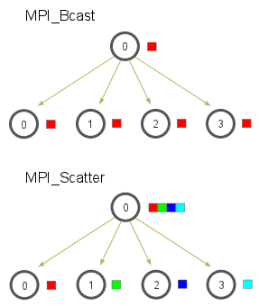
MPI_Bcast and MPI_scatter

Slide 8
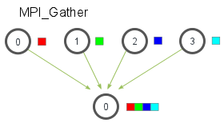
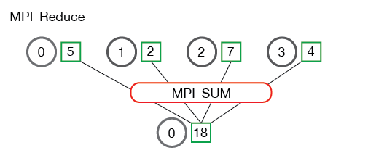
MPI_Gather and MPI_Reduce
https://rookiehpc.github.io/mpi/docs/mpi_reduce/index.html
https://www.codingame.com/playgrounds/349/introduction-to-mpi/reductions

Slide 9
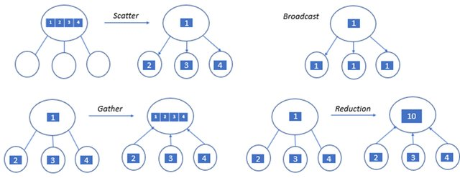

Slide 10
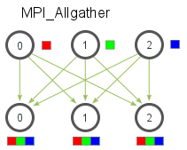
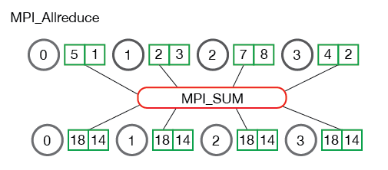
MPI Allgather and MPI Allreduce

Slide 11
Collective Communication Operations
The gather operation is performed in MPI using:
  int MPI_Gather(void *sendbuf, int sendcount,
  MPI_Datatype senddatatype, void *recvbuf,
  int recvcount, MPI_Datatype recvdatatype,
  int target, MPI_Comm comm)
MPI also provides the MPI_Allgather function in which the data are gathered at all the processes.
  int MPI_Allgather(void *sendbuf, int sendcount, MPI_Datatype senddatatype, void *recvbuf,
  int recvcount, MPI_Datatype recvdatatype,
  MPI_Comm comm)
The corresponding scatter operation is:
  int MPI_Scatter(void *sendbuf, int sendcount,
  MPI_Datatype senddatatype, void *recvbuf,
  int recvcount, MPI_Datatype recvdatatype,
  int source, MPI_Comm comm)

Slide 12
Collective Communication Operations
If the result of the reduction operation is needed by all processes, MPI provides:
  int MPI_Allreduce(void *sendbuf, void *recvbuf, int count, MPI_Datatype datatype, MPI_Op op, MPI_Comm comm)

